Slide 1
BT201
Biochemical Process Calculations
10/08/2022

Slide 2
Material balances for single unit without reaction
Splitting
F₀
F₁
Feed stream
Exit stream 1
Exit stream 2
F₂
Total Molar balance: F₀ =F₁ + F₂
Volumetric flow rate: v₀ =v₁ + v₂
(as no reaction)
One independent equation as the concentration of compositions are same in all three streams

Slide 3




Cont.
Feed stream (sp. gravity =1.1) having 30% glycerol, (w/w) flowing at a flow rate of 100 L/h is divided in two feed streams for two bioreactors. One-third is going into bioreactor 1 and remaining portion is going to 2nd reactor. What is the flow rate of glycerol in terms of gm/min in the feed stream for reactor 2?
v=100 L/h
$\dot{m}$=100 *1.1 =110 kg/h
v₁
v₂
30% glycerol, w/w
$\dot{m_{1}}$=
$\dot{m_{2}}$=$\dot{{2m}_{1}}$
1
2
2v/3
Rate of accumulation = rate of input - rate of output + rate of generation - rate of consumption
rate of input = rate of output
$0=110−\dot{(\dot{m_{1}} }$+ $\dot{m_{2})}+0−0$

Slide 4




$\dot{(\dot{m_{1}} }$+ $\dot{m_{2})}=110$
$\dot{(\dot{m_{1}} }$+ $\dot{{2m}_{1})}=110$
$\dot{m_{1}}$=36.667 kg/h
$\dot{m_{2}}$=73.333 kg/h
Glycerol flowrate in 2nd reactor= 73.33 *0.3=21.999 kg/h=0.367 gm/min

Slide 5
Material balances: Mixer
Feed 2
Component: C,D, may be A and B also
Mixer
Feed 1
Mixed product
Component: A,B
Component: A,B,C,D
Input: more than one feed stream
Out put: one stream
No of materials balance?
Overall mass balance
Component balance
For this case total mass balance equation is dependent

Slide 6
Cont.
A pharmaceutical drug containing 10% (w/w) API, 5% (w/w) sorbitol in water, can be prepared by mixing three feed streams; Feed 1: 50% (w/w) API in water, Feed 2: 40 % (w/w) sorbitol in water and Feed 3: pure water. How much Feed 1 , Feed 2 and Feed 3 should be mixed to produce 100 Liters of product. Assume density is equal to 1 kg/L for all the feed streams and as well as product stream also.
Feed 2
API: 0%
sorbitol: 40%
water: 60%
Mixer
Feed 1
Product
(100 Liters)
API: 50%
sorbitol: 0%
water: 50%
API: 10 %
Sorbitol: 5%
Water: 85%
API: 0%
sorbitol: 0%
water:100%
Feed 3

Slide 7
Cont.
Feed 2
m₂ kg
API: 0%
sorbitol: 40%
water: 60%
Basis: 100 liter product
Product: 100 L=100 L*1 kg/L=100 kg
Feed 1
m₁ kg
Mixer
Product (100 kg)
API: 50%
sorbitol: 0%
water: 50%
Overall mass balance:
m₁+m₂+m₃=100
API: 10 %
Sorbitol: 5%
Water: 85%
API: 0%
sorbitol: 0%
water: 100%
Feed 3
m₃ kg
component mass balance:
API: 0.5*m₁+0*m₂+0*m₃=0.1*100 m₁=20 kg
Sorbitol: 0*m₁+0.4*m₂+0*m₃=0.05*100 m₂: 12.5 kg
m₃: 100-20-12.5 kg=67.5 kg
Cross check by water mass balance:
0.5*m₁+0.6*m₂+1.0*m₃=0.85*100 m₃=67.5 kg

Slide 8
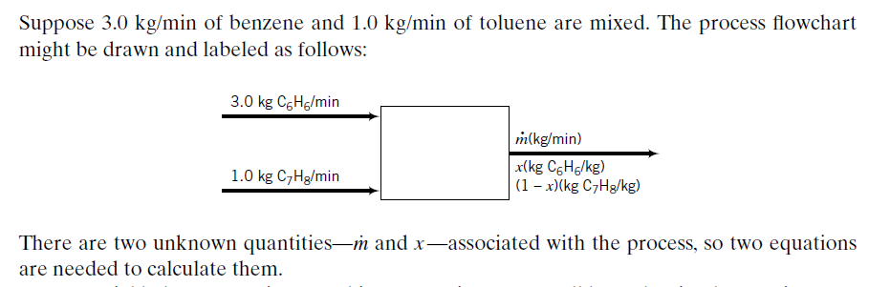
Cont.
Mass fraction of benzene in outlet?

Slide 9
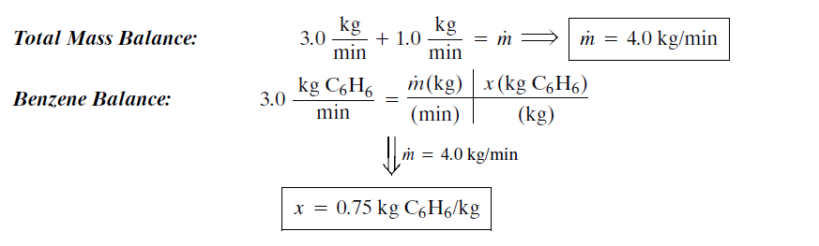

Slide 10
Material balances: Dryer
Wet feed is dried by supplying heat (hot gas, hot air)
Feed can be solid, solution or slurry
Solvent stream is vapor and solid free
Product stream typically solid and may contain small amount of solvent
solvent
dryer
Dryer feed
Dried product
Input: one feed stream
Out put: two stream
No of materials balance?

Slide 11
Material balances: Evaporator
solvent
evaporator
Dryer feed
(liquid)
Dried product
Similar to dryer but feed is always a liquid

Slide 12
Cont..
An experiment on the growth rate of certain organisms requires an environment of humid air enriched in oxygen. Three input streams are fed into an evaporation chamber to produce an output stream with the desired composition.
A: Liquid water, fed at a rate of 20.0 cm³ /min
B: Air (21 mole% O , the balance N)
C: Pure oxygen, with a molar flow rate one-fifth of the molar flow rate of stream B
The output gas is analyzed and is found to contain 1.5 mole% water. Draw and label a flowchart of the process, and calculate all unknown stream variables.
C
(F3, =0.2*F1 mol/min)
O2: 100 mol%
Evaporation
Air:
Water: 1.5 ,mole %
B
(F2, mol/min)
O2: 21 mol%
N2: 79 mol%
A
(F1, mol/min). 20 cc water /min

Slide 13
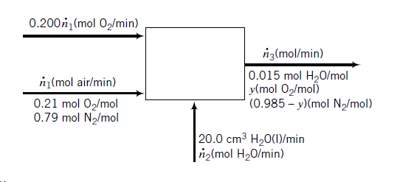



Slide 14
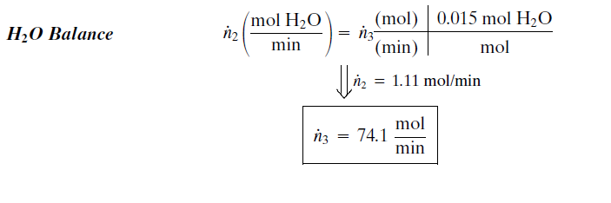
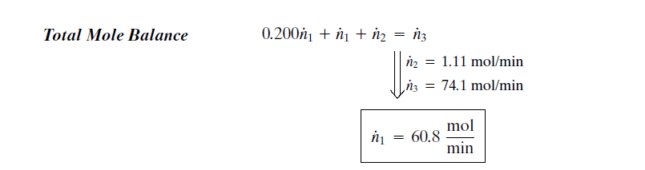

Slide 15
